Slide 1

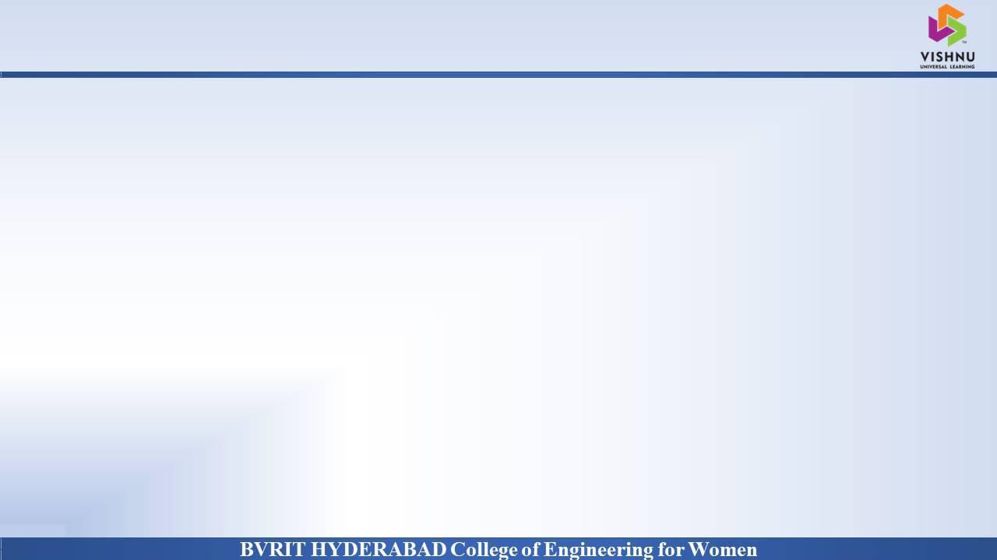
Department of Computer Science & Engineering
COVID-19 Social Distance Monitoring System using YOLO
Date: 17 May 2021
A. GEETHA : 17WH1A0508
P. RAGHAVARSHINI : 17WH1A0528
A. SWATHI : 17WH1A0546
Internal Guide : Ms. Swapna D
Designation : Associate Professor

Slide 2


ABSTRACT
Why Should I Study this course?
Examples
BVRIT HYDERABAD College of Engineering for Women
In the fight against the COVID-19, social distancing has proven to be a very effective measure to slow down the spread of the disease. People are asked to limit their interactions with each other, reducing the chances of the virus being spread with physical or close contact. In past also ML/Deep Learning has shown promising results on a number of daily life problems. In this proposed system we will see the detailed explanation of how we can use Python, Computer Vision and Deep learning to monitor social distancing at public places and workplaces. To ensure social distancing protocol in public places and workplace, the social distancing detection tool that can monitor if people are keeping a safe distance from each other by analyzing real time video streams from the camera, Monitoring People at workplaces, factories, shops we can integrate this tool to their security camera systems and can monitor whether people are keeping a safe distance from each other or not.

Slide 3
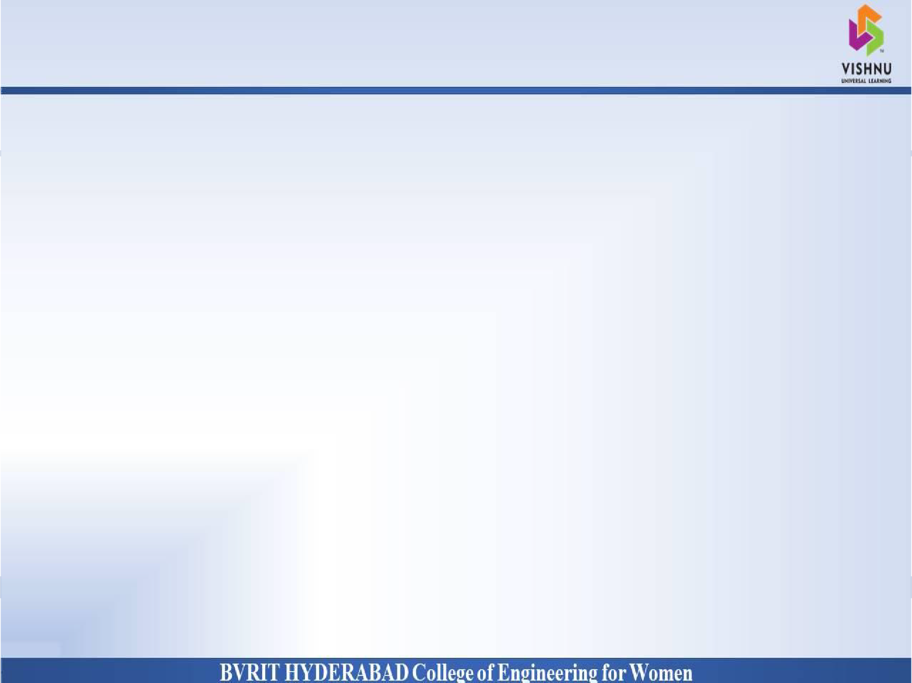
DATASET
Why Should I Study this course?
Examples
BVRIT HYDERABAD College of Engineering for Women
Dataset Description:
The model is trained on COCO dataset (Common Objects in Context).
COCO, is large image recognition/classification, object detection, segmentation dataset .
It contains 320k images and 80 object categories.

Slide 4
ARCHITECTURE
Why Should I Study this course?
Examples
BVRIT HYDERABAD College of Engineering for Women
Input
(Video/Frame)
Object Detection (Filtering only people class)
Check if the number of person is > 1
Decision for safe or unsafe condition
Compute the Distance between
centroid of bounding boxes

Slide 5
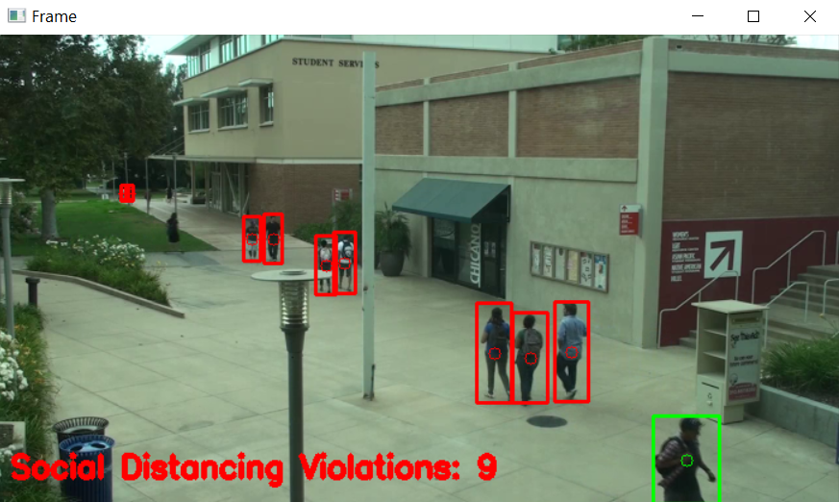
OUTPUT
Why Should I Study this course?
Examples
BVRIT HYDERABAD College of Engineering for Women

Slide 6
TECHNOLOGY STACK
Why Should I Study this course?
Examples
BVRIT HYDERABAD College of Engineering for Women
Python 3.6
Libraries
Numpy
OpenCV
Imutils
SciPy

Slide 7
SYSTEM SOFTWARE
Why Should I Study this course?
Examples
BVRIT HYDERABAD College of Engineering for Women
ENVIRONMENT | SPECIFICATIONS
HARDWARE | Processor - Intel Core i5 Memory(RAM) - 8 GB Storage – 1 TB
SOFTWARE | Python OS - Windows 10 Anaconda-Jupyter notebook

Slide 8
TIMELINE
Why Should I Study this course?
Examples
BVRIT HYDERABAD College of Engineering for Women
REVIEW 0 | Abstract Base Papers and References
REVIEW 1 | Requirements & Specifications Architecture
REVIEW 2 | Apply YOLOv3 Algorithm and DNN Algorithm
REVIEW 3 | Complete Implementation Results and Discussions

Slide 9
REFERENCES
Why Should I Study this course?
Examples
BVRIT HYDERABAD College of Engineering for Women
[1] Base paper
https://ieeexplore.ieee.org/document/9204934
[2] Reference papers
https://www.irjet.net/archives/V7/i6/IRJET-V7I6422.pdf
https://link.springer.com/article/10.1007/s11554-021-01070-6

Slide 10
Thank you

